Slide 1
WE HAVE BEEN CALLED TO THIS HOUR
evening Prayer Tuesday, March 29, 2022
Cathedral of Saint Mary of the Assumption, San Francisco, CA

Slide 2
Now is the Time
Now is the time and we are the ones to speak out for justice, for mercy and truth.
Now is the time and we are the ones to live with compassion
and lift up all those with no voice.
x2
Cathedral of Saint Mary of the Assumption, San Francisco, CA

Slide 3
Let us listen to words of wisdom regarding the synod. Pause and reflect on the message you are receiving from each passage:
Cathedral of Saint Mary of the Assumption, San Francisco, CA

Slide 4
Our mission is to witness to the love of God in the midst of the whole human family. . . in this way, synodality is a path by which the Church can more fruitfully fulfil her mission of evangelization in the world, as a leaven at the service of the coming of God’s kingdom.
Cathedral of Saint Mary of the Assumption, San Francisco, CA

Slide 5
We need to be open to conversion and change. We can often be resistant to what the Holy Spirit is trying to inspire us to undertake. We are called to abandon attitudes of complacency and comfort that lead us to make decisions purely on the basis of how things have been done in the past.
Cathedral of Saint Mary of the Assumption, San Francisco, CA

Slide 6
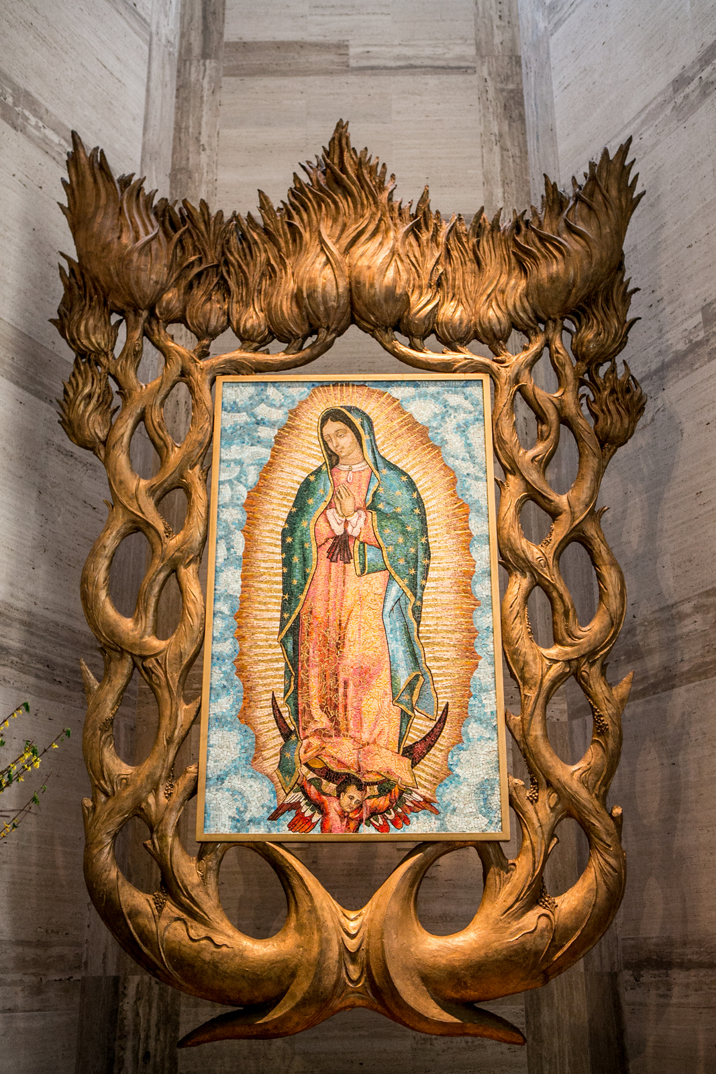
We are signs of a Church that listens and journeys: By listening, the Church follows the example of God, who listens to the cry of the people. The Synodal Process provides us with the opportunity to open ourselves to listen in an authentic way, without resorting to ready-made answers or pre-formulated judgments.
Cathedral of Saint Mary of the Assumption, San Francisco, CA

Slide 7
Now is the time and we are the ones to speak out for justice, for mercy and truth.
Now is the time and we are the ones to live with compassion and lift up all those with no voice.
Cathedral of Saint Mary of the Assumption, San Francisco, CA

Slide 8
Who will listen to the forgotten mistreated and lonely
When will we give love and compassion and hope?
If not now, then when?
If not us, then who?
Cathedral of Saint Mary of the Assumption, San Francisco, CA

Slide 9
Now is the time and we are the ones to speak out for justice, for mercy and truth.
Now is the time and we are the ones to live with compassion
and lift up all those with no voice.
Cathedral of Saint Mary of the Assumption, San Francisco, CA

Slide 10
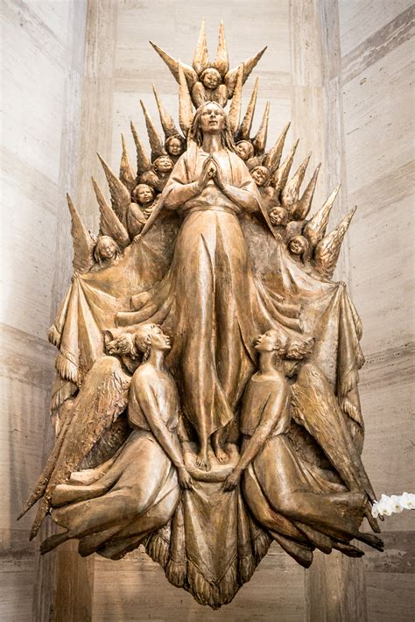
We must be cured of the virus of self-sufficiency: Together we form the Body of Christ. Setting aside the mirage of self-sufficiency we are able to learn from each other, journey together, and be at the service of one another. We can build bridges beyond the walls that sometimes threaten to separate us.
Cathedral of Saint Mary of the Assumption, San Francisco, CA

Slide 11
Synods are a time to dream and “spend time with the future.” Let us embrace:
inclusivity
open mindedness
an attitude of listening and understanding of what it means to journey together – to walk the path that God calls the Church to undertake for the third millennium
Cathedral of Saint Mary of the Assumption, San Francisco, CA

Slide 12
Now is the time and we are the ones to speak out for justice, for mercy and truth.
Now is the time and we are the ones to live with compassion
and lift up all those with no voice.
Cathedral of Saint Mary of the Assumption, San Francisco, CA

Slide 13
Who welcome all to God’s Circle of Love and Belonging? When will all be gathered together as one? If not now, then when, if not us, then who?
Cathedral of Saint Mary of the Assumption, San Francisco, CA

Slide 14
Now is the time and we are the ones to speak out for justice, for mercy and truth.
Now is the time and we are the ones to live with compassion
and lift up all those with no voice.
Cathedral of Saint Mary of the Assumption, San Francisco, CA

Slide 15
Closing Prayer: Gracious God, as this day comes to its close, help us to be mindful of all the ways you graced and enriched our lives. Today we engaged in compelling processes, were enlightened by the wisdom of others and were delighted in surprising ways.
Cathedral of Saint Mary of the Assumption, San Francisco, CA

Slide 16
As we reflect on our day, we ask your pardon for the times our minds wandered and we were inclined to be dismissive or judgmental; for those times we were unintentionally abrupt or unkind.
Cathedral of Saint Mary of the Assumption, San Francisco, CA

Slide 17
Gracious God, we are confident that you forgive us our transgressions and embrace us with parental love. For those graced moments of our day we are grateful. Keep us faithful to your teachings and never let us be parted from you. Amen.
Cathedral of Saint Mary of the Assumption, San Francisco, CA

Slide 18
Now is the time and we are the ones to speak out for justice, for mercy and truth.
Now is the time and we are the ones to live with compassion
and lift up all those with no voice.
x2
Cathedral of Saint Mary of the Assumption, San Francisco, CA

