Slide 1
We Pray for Peace in Ukraine and in Our World
Morning Prayer Tuesday, March 29, 2022
Dominican Church, Lviv, Ukraine

Slide 2
Dona Nobis Pacem
https://www.youtube.com/watch?v=OSdGW_HBrLE

Slide 3
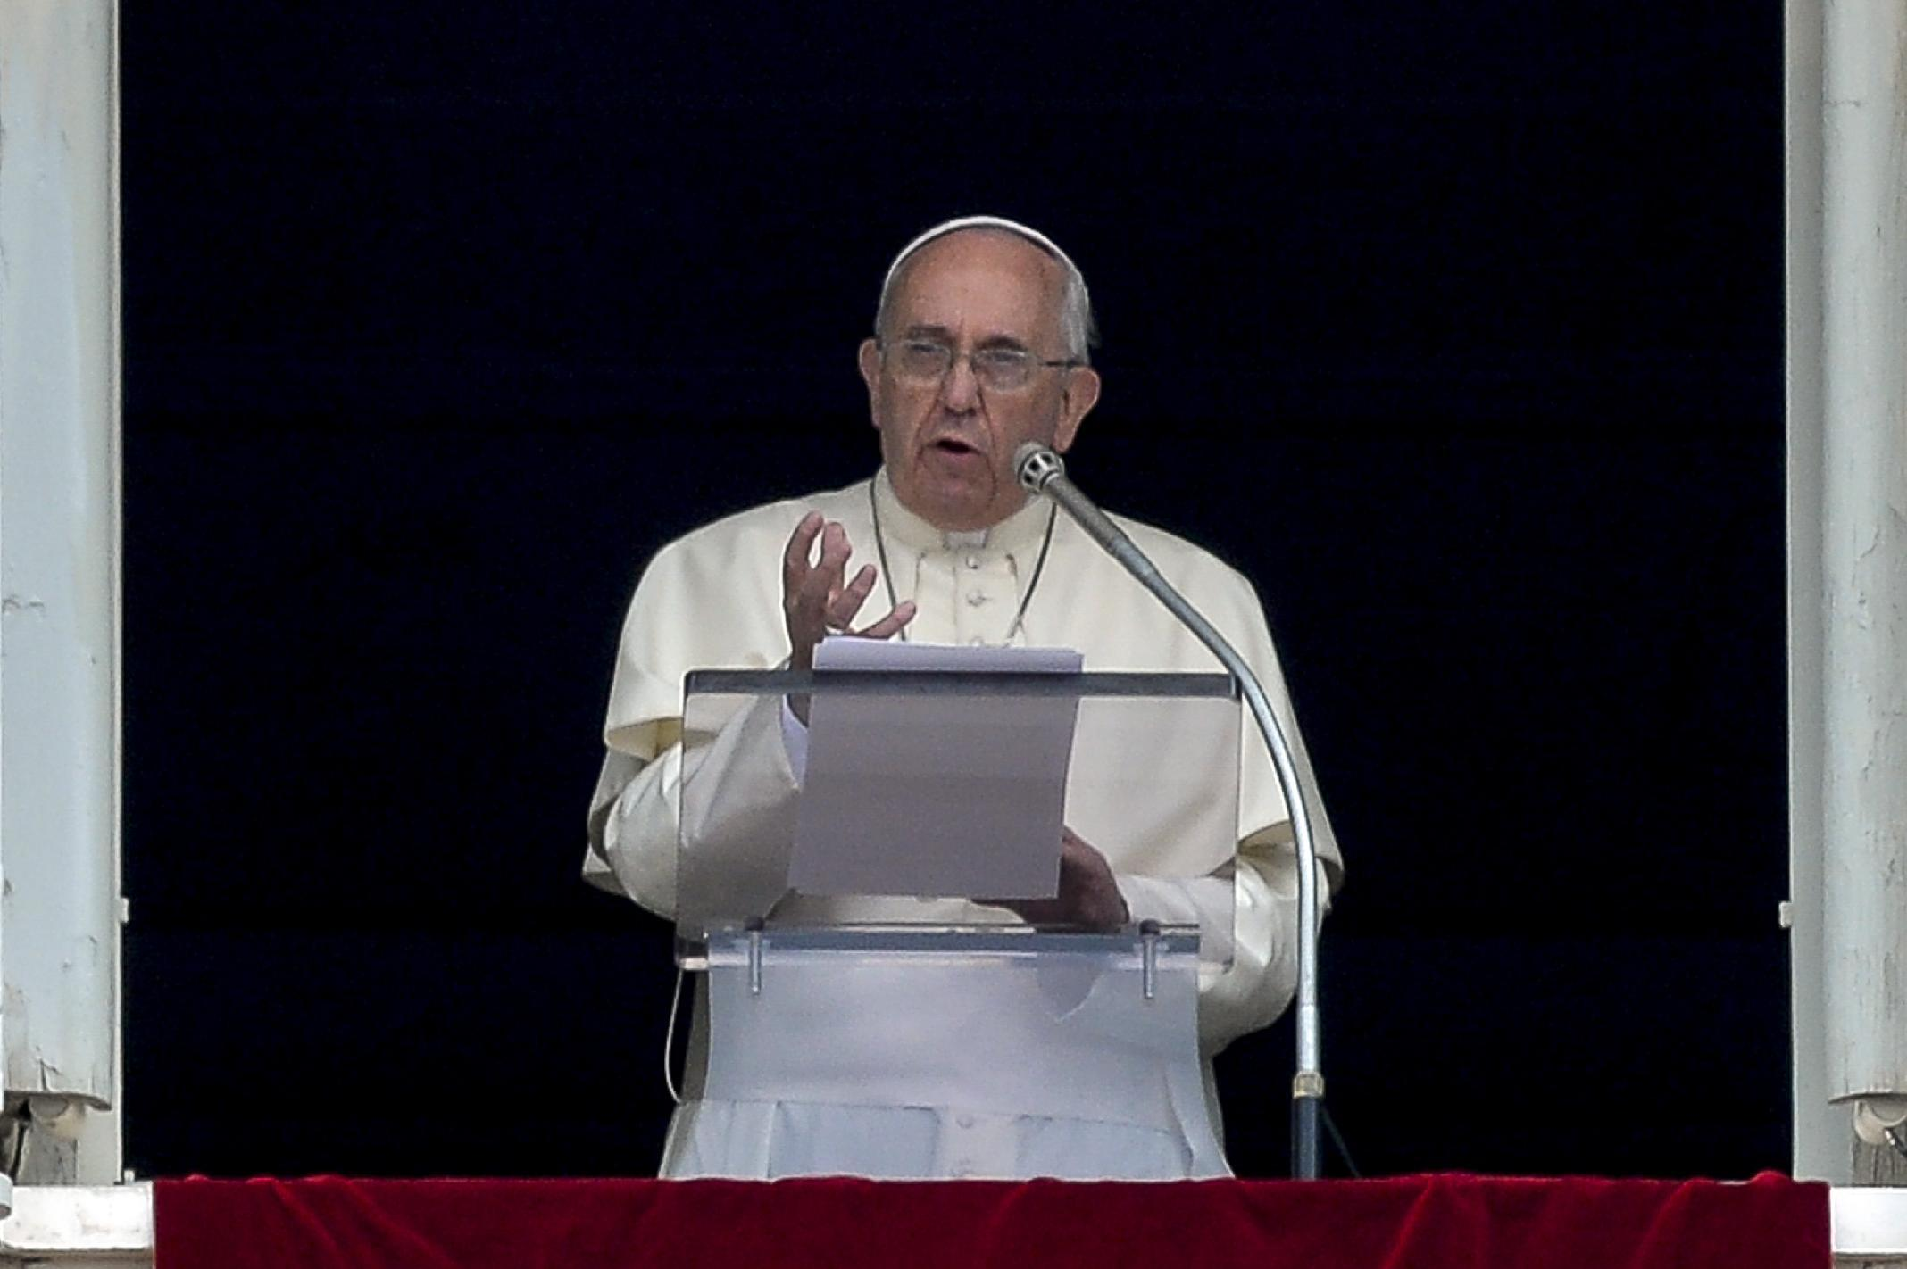
Prayer by Pope Francis:
Reader One:
An introduction to the prayer for peace by Pope Francis: “…war is a failure of politics and of humanity, a shameful capitulation, a stinging defeat before the forces of evil.”

Slide 4
Reader Two:
We lament the loss of life and the unnecessary suffering that is unfolding in Ukraine and in our weary world. We stand with the Ukrainian people and urge Russia to end this pointless and unwarranted conflict.
Dominican Church, Lviv, Ukraine

Slide 5
We also recognize and stand in solidarity with those protesting in Russia to try to get their government to choose a different, peaceable course of action. The unrest, uncertainty and trauma this war is causing is immeasurable and will affect the entire global village. In this moment, we pray knowing God hears our cries. Let us pray.
Dominican Church, Lviv, Ukraine

Slide 6
Together: Hear us, God of Peace.
(A moment of silence)
St. Michael’s Golden-Domed Monastery of Kyiv

Slide 7
Reader One:
We pray today for the Ukrainian people and ask for Your intervention in this senseless war. We pray, O God and to our Mother of Mercy, for protection and that there will be peace. We pray for restoration and renewed hope. We pray for families, especially, the children living through the horrors of war and all of the tribulation it brings.
St. Michael’s Golden-Domed Monastery of Kyiv

Slide 8
We pray for all those protesting in Russia against these violent acts by their government. We pray for the entire world community, including the leaders in our own country. Give them wisdom and insight to respond in ways that end this war and move us all to a world where Your Peace abides. Hear the cries of Your people, O God. Lord have mercy. Christ have mercy. (Prayer from the U.S. Council of Churches)
St. Michael’s Golden-Domed Monastery of Kyiv

Slide 9
Together: Amen! Amen! Amen!
St. Michael’s Golden-Domed Monastery of Kyiv

Slide 10
(A moment of silence)

Slide 11
Make Me a Channel of Your Peace

